Slide 1


DESIGN AND DEVELOPMENT OF A ROBOTIC DISINFECTANT SYSTEM
Final review- 08, October 2021
TEAM 07: ANDRO WIZARDS
DEVASHISH SHARMA (20130032)
SARAN R (20130011)
SAHIL AHAMED SHAIK (20130006)
HEMANG PARAB (20130016)
PROJECT GUIDE:
DR. RM. KUPPAN CHETTY
Associate professor
PROJECT CO-GUIDE:
DR. NAKANDHRAKUMAR
Assistant Professor (SG)

Slide 2
PROBLEM STATEMENT
WHO HAS THE PROBLEM?
Humans
WHAT IS THE PROBLEM?
WHY IS IT IMPORTANT TO ADDRESS?
The spread of virus we need to sanitize regularly touched surfaces.
It's important to sanitize the environment at regular intervals to prevent spread of virus.
WHERE IS THE PROBLEM OCCURING?
At high density public places such as train coaches, shopping malls, general stores, etc.

Slide 3

OBJECTIVES
Objective 1
Objective 2
To avoid the objects and people around it. The robot, senses the environment, gets the feedback, and avoids the interference like objects/obstacles this whole system will work on microcontroller and programming of same as per our need.
To spray the disinfecting fluid stored in the tank around the environment with the prefixed actuators in the air with a refreshing smell.

Slide 4
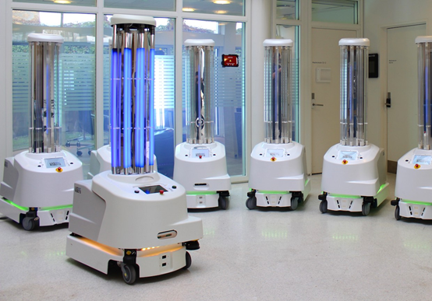
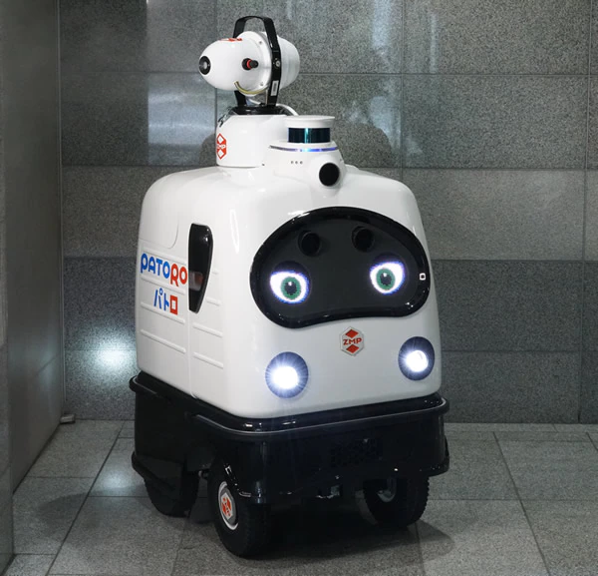

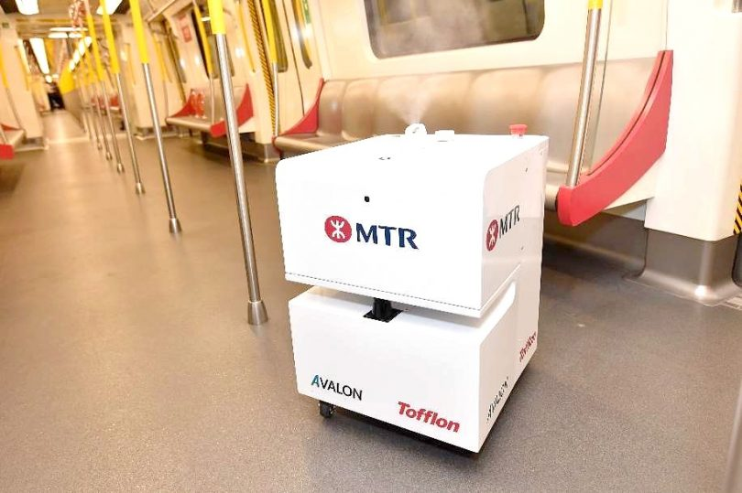

Concept – Idea
Disinfectant Robot - PATORO
Vapourised Hydrogen Peroxide Robot”

Slide 5


PROJECT PLAN
Week 2
Week 4
Week 6
COMPONENT SELECTION
SIMULATION OF CIRCUIT + CODING
SIMULATING MECHANICAL MODEL
Week 1
Week 3
Week 5
Next page
BRAINSTORMING
SIMULATION OF CIRCUIT + CODING
DESIGNING OUTER CHASSIS

Slide 6


PROJECT PLAN
Week 7
Week 9
Week 11
Week 13
SIMULATING MECHANICAL MODEL.
PROTOTYPING
TESTING AND FIXING ERRORS.
PRESENTATION #winning
Week 8
Week 10
Week 12
PROTOTYPING.
PROTOTYPING.
PREPARING SUPPORTING MATERIAL(ppt)

Slide 7
GANTT CHART
 | Week 1 | Week 2 | Week 3 | Week 4 | Week 5 | Week 6 | Week 7 | Week 8 | Week 9 | Week 10 | Week 11
Brainstorming | X
Component selection |  | X
Simulation of circuit |  |  | X | X | X
Coding |  |  | X | X | X
Designing chassis |  |  |  |  | X | X
Simulating mechanical outline |  |  |  |  |  | X | X
Prototyping |  |  |  |  |  |  |  | X | X | X | X
Testing |  |  |  |  |  |  |  |  |  | X | X

Slide 8
LITERATURE REVIEW

Slide 9


JOURNAL AUTHOR INFERENCE
SANITIZATION ROBOT
International Research Journal of Engineering and Technology (IRJET) , Volume: 07
Issue: 08 , Aug 2020
Apeksha Wadibhasme,
Yedhubooshan M M, Kaushik Moolya, Shireen Farhath, Dipti
Darade, Sumana Hati
We learned all the components, their usage and basic idea of creating the system
01
02
Obstacle Avoidance Robot Using Arduino,International Journal of Engineering Research & Technology (IJERT).Issue - volume6 issue 13,year-2018.
Pavithra A C and Subramanya Goutham V.
Learned the mechanism of obstacle avoiding design
03
Obstacle Avoiding Robot,Global Journal of Researches in Engineering: H Robotics & Nano-Tech,Volume 17 Issue : 1 Version 1.0 ,Year 2017
Faiza Tabassum, Susmita Lopa, Muhammad Masud Tarek
& Dr. Bilkis Jamal Ferdosi.
Learned the mechanism of obstacle avoiding design

Slide 10
JOURNAL AUTHOR INFERENCE
04
Autonomous Navigation and Obstacle Avoidance Vehicle.
Written report issued year : 2008
Kyuhyong You
Learned the mechanism of obstacle avoiding design
05
International Journal of Soft Computing and Engineering (IJSCE). Issue :Volume-3, Issue-4, September 2013, pg 52-55
Vivek Hanumante Sahadev Roy Santanu Maity.
Learned distance measurement and working principle.
06
Intelligent tracking obstacle avoidance wheel robot.
Kunming university of science and technology,China
Issued : 2019
Elsevier B.V
Learned distance measurement and working principle

Slide 11
JOURNAL AUTHOR INFERENCE
07
Design of Disinfection Robot for Livestock Breeding
Year of publication: 2013
Qing Chun Feng
We understood the mechanism of spray Nozel and system structure
Tolga Özer , Sinan Kıvrak , Yüksel Oğuz
learned the working of h-bridge motor driver
08
H Bridge DC Motor Driver Design and Implementation with Using dsPIC30f4011
Year of publication: 2017
M. Z. A Rashid , M. F. Abdul Latif , M. Nur Othman & Marizan Sulaiman
Learning the steps to design and test a chassis
09
Design and Simulation Study of Small Four Wheel Vehicle Chassis for Single Driver
Year of publication:2015

Slide 12
COMPONENTS SELECTION

Slide 13
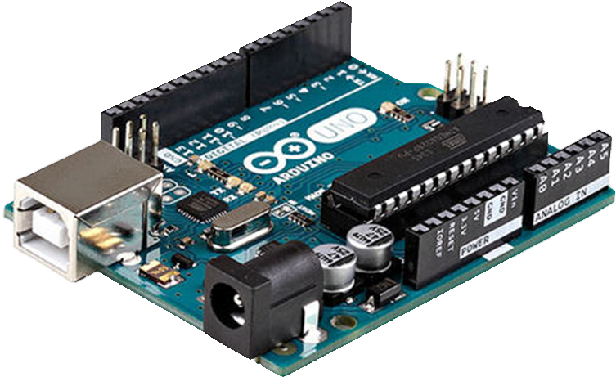
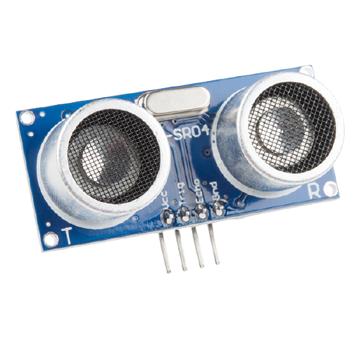
It is powered by USB port plus a 12v input post also available on board
The board contains other components like PWM pins, timers, external interrupts or internal interrupts, using USB interface it enables the board to act as a serial device.
On board pins are capable of providing constant power supply of 5v.
Arduino
UNO
Ultrasonic sensor for detecting obstacles in path is that it can be used in dark environment, it is not affected by colour or transparency of object and it is costs less.
Range Specified: 100cms
Ultrasonic sensor

Slide 14
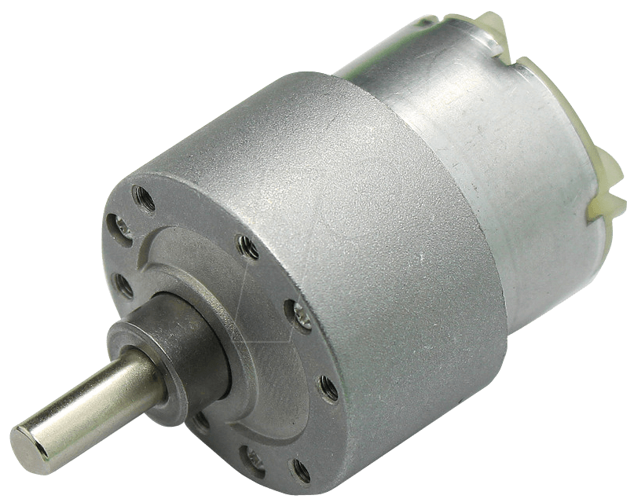
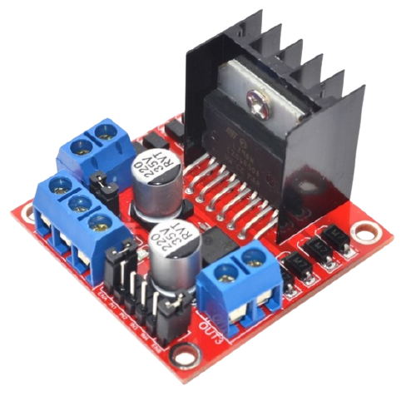
In this project we are using 12v geared DC motors that are capable of providing torque of 12 kg-cm
Also these motors are of 45 RPMs for steady movement of robot.
DC
motors
Advantage of using L298N motor drive is that it supports high torque motors i.e., it is capable of drawing high ampere of current as compared to other motor drivers.
Moreover, it can withstand up to 46v of supply and it comes with a heat sink for excessive heat dissipation.
Motor
driver

Slide 15
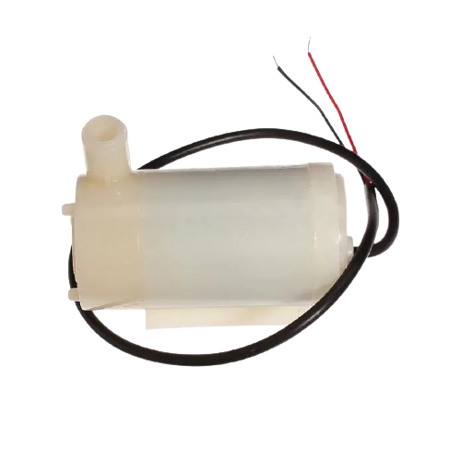
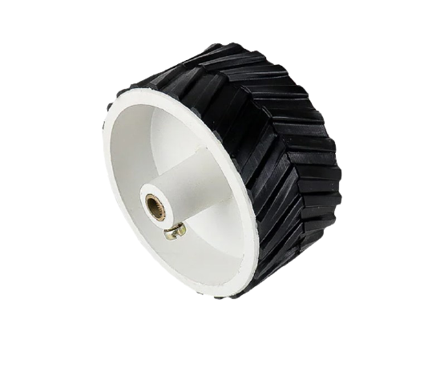
The pump used is capable of drawing 1ml sanitization liquid per second through a spray nozzle
It sprays up to the distance of 30 cm and covers an area of 150cm^2
Water
pump
Wheels of 8cm radius is used to provide suitable torque and width of 1cm is used with rubber grip to gain proper traction for movement.
Wheels

Slide 16
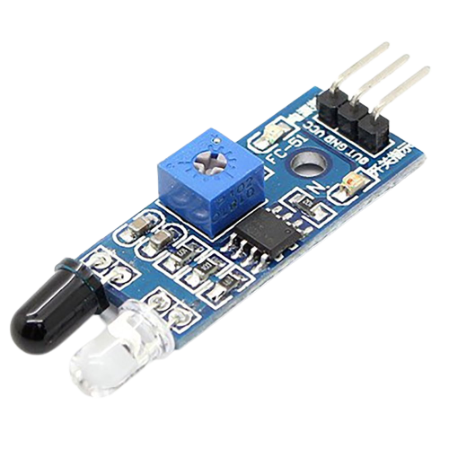
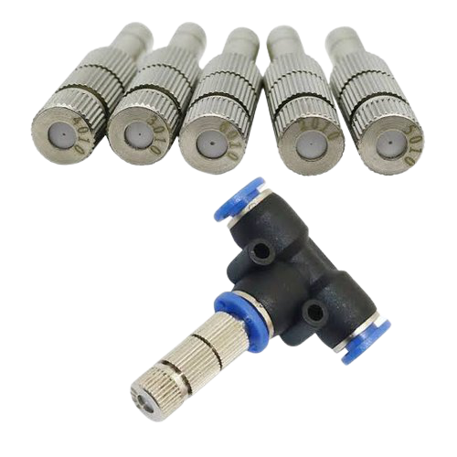
IR Sensor used for detecting surfaces to be sprayed with sanitizer
its specified range is 30cm at most
IR sensor
A spray nozzle is a precision device that facilitates dispersion of liquid into a spray.
Nozzles are used to distribute a liquid over an area, to increase liquid surface area
Spray
nozzle

Slide 17
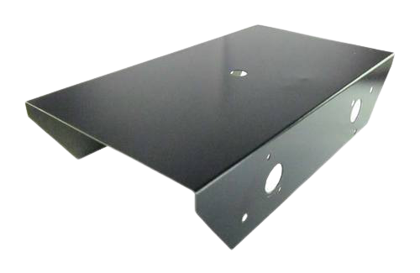
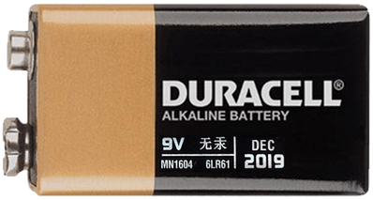
The chassis used is of mild steel which is capable of holding weight up to 6kgs.
Dimensions - Length=22cm; width= 17cm; height= 6cm
Chassis
A battery packet of 2000mAh lithium polymer is used with 3 cells, the battery is re-chargeable.
The battery will withstand for 45 mins once fully charged.
Battery

Slide 18
METHODOLOGY

Slide 19
Sanitizing module:
Methodology
Ultrasonic sensor
Arduino UNO
Motor Driver (L298N)
DC Motor
IR Sensors
Arduino UNO
DC Motor Pump
Obstacle avoidance:

Slide 20
Block diagram

Slide 21
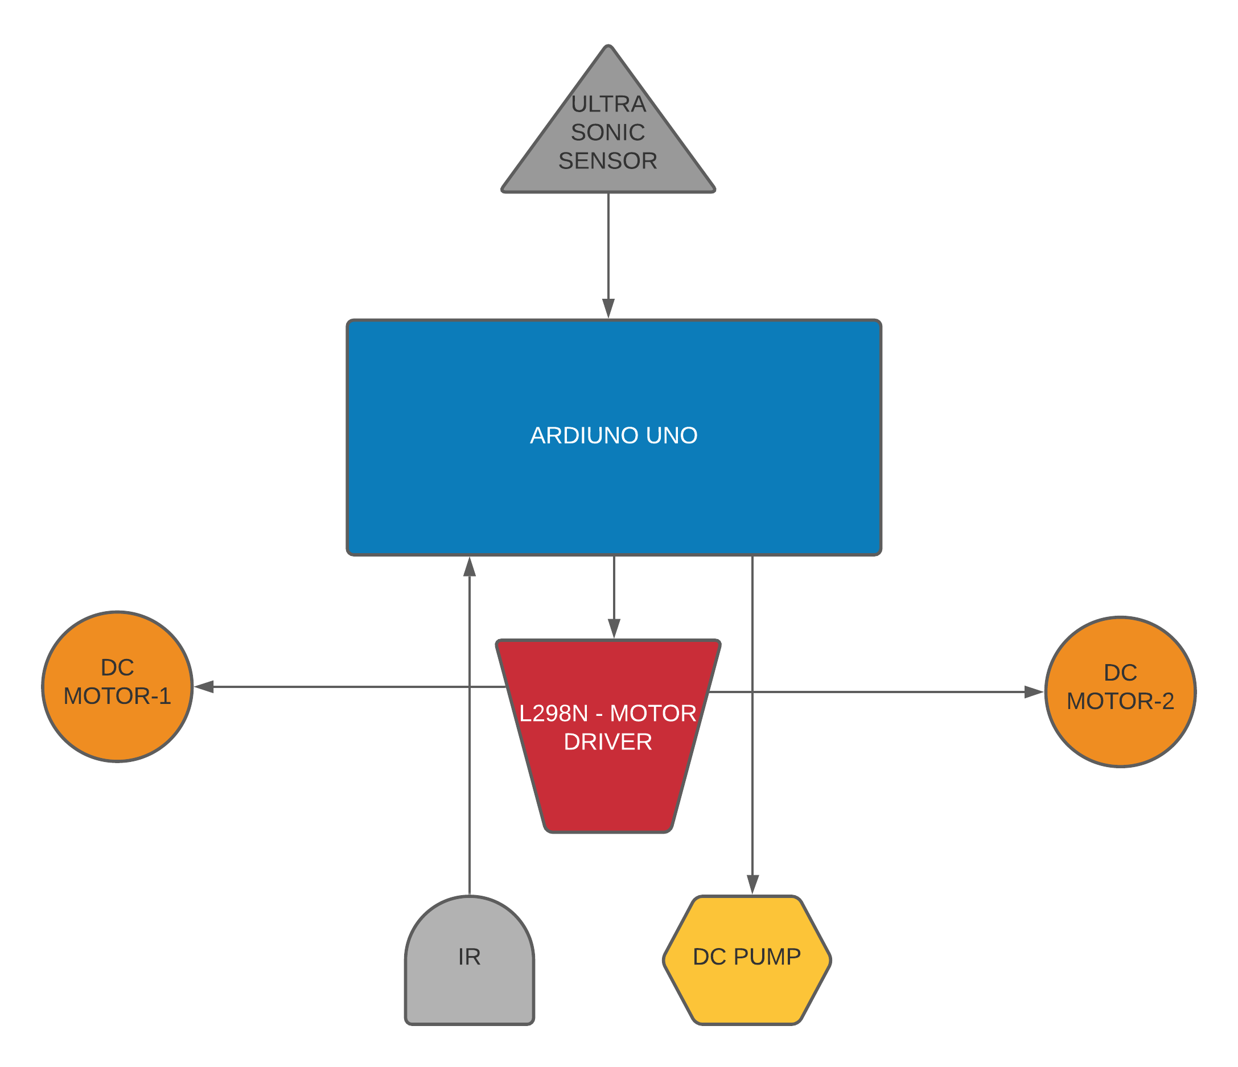

Slide 22
Load calculation Total wheel drive = 02 Load = 4kg Safety factor = 1.5 Total payload = 4 x 1.5 = 6kg Load on each wheel = 6/2 = 3kg Radius of wheel = 4cm Formula available for torque of wheel: Tw = TTE(kg) x Rw(cm) x RF Tw: torque of wheel TTE: total tractive effort (load) Rw: radius of wheel RF: resistance factor Tw = 3kg x 4cm x 1 = 12 kg-cm RPM of motor = 45 Total distance covered in 1 min = RPM x circumference = 45 x 2 x π x r = 45 x 2 x 3.14 x 4 = 1130.4 cm = 11.304 m = 11m(approx.)
COMPUTATIONS AND CALCULATIONS

Slide 23
Sanitization mechanism Total tank capacity= 1500ml
Total continues spray time = 26 min
= 1560sec
Liquid dispensed per second = 1500/1560
= 0.9615 ml/s
= 1ml/s (approx.)
Object detection mechanism
Distance =(duration/2)/29.1
duration= time taken by the receiver to receive the transmitted signal

Slide 24
SOFTWARES USED

Slide 25




SOFTWARES USED

Slide 26
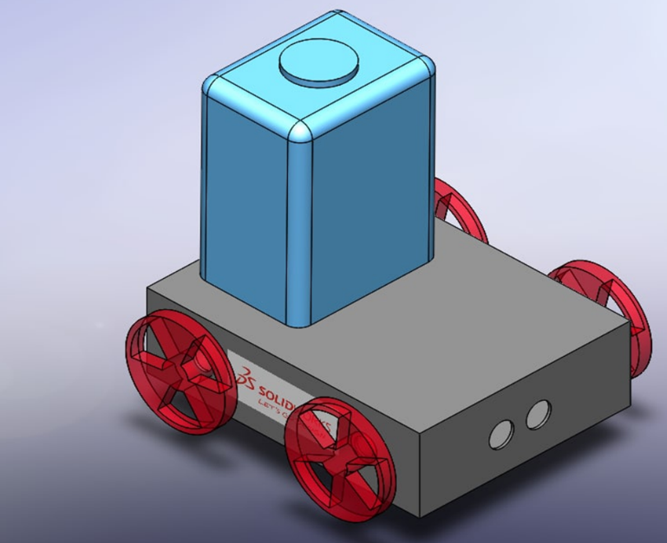
Solid Works
This is the mechanical model created using solidworks which consist of chassis, wheels and sanitizing tank which represents our basic idea how real model looks like with accurate looks and dimension.

Slide 27
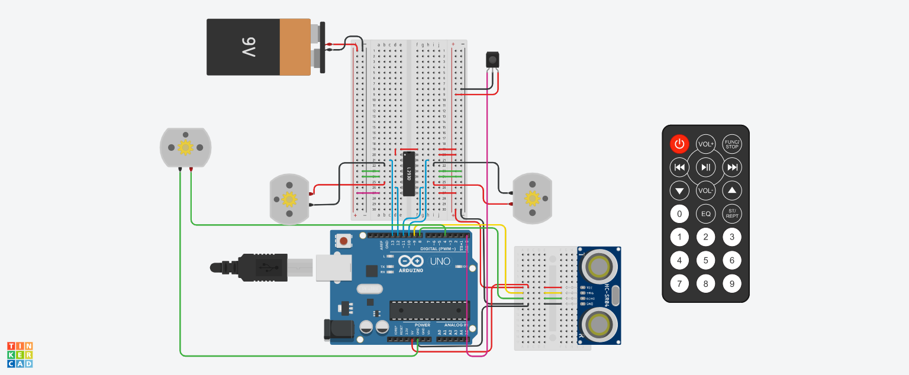
Circuit
This is the digital circuit designed in tinkercad representing the functionality of our robotic system which includes obstacle avoidance and sanitizer spraying.

Slide 28
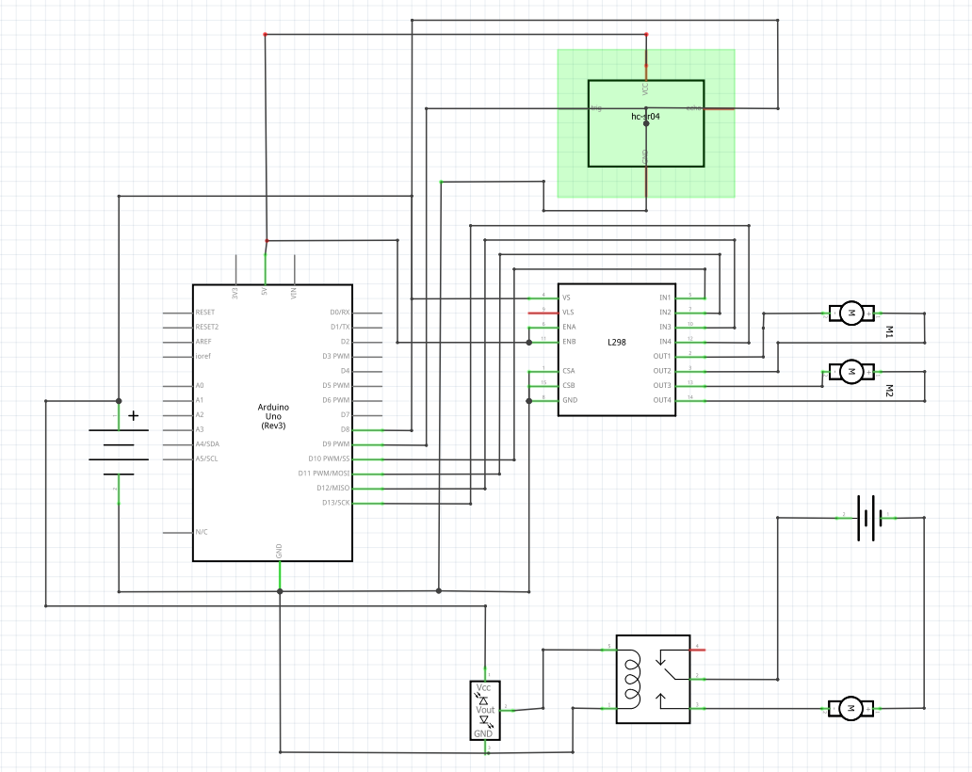
Circuit-block diagram

Slide 29
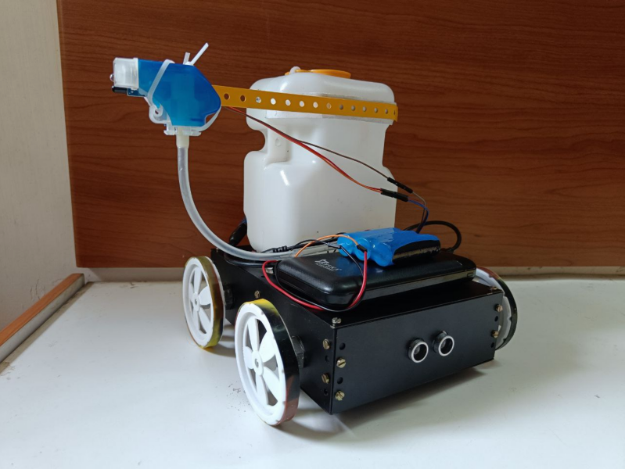
Conclusion
Key points:
The robot has been designed and the obstacle avoidance function is successful.
The simultaneous function of the sanitizing spray is successful.
The simulation in software and designing in tinkercad and solidworks is completed.
The designing of chassis and stress analysis is successful.
The lessons learnt from setbacks are the major learning for future projects.

Slide 30

Thanks!
ANY QUESTIONS?

